Slide 1
CREDIT SCORING SYSTEM
GUIDE NAME: Mr. P.B. ARAVIND PRASAD.,M.Tech
(AP/AI)
TEAM MEMBERS:
R. MONISH VIDYARTHI (811721243035)
P. MADHUMITHA (811721243026)
M. KANNIGA SARASWATHY (811721243024)
A. SUBALATHA (811721243054)

Slide 2
OBJECTIVE:
A credit scoring system is a tool used by financial institutions, lenders, and other organizations to evaluate the creditworthiness of individuals or businesses. It assigns a numerical score that represents a person’s ability to repay loans and fulfill financial obligations.
Credit scoring system employs Gradient boosting machines and LightGBM for accessing the creditworthiness of individuals or business based on historical data .
XGBoost will be implemented to analyze and score credit data. XGBoost’s capability to handle large amounts of structured data makes it suitable for processing multiple financial and demographic variables while identifying subtle patterns associated with credit risk.
The goal is to demonstrate the capability of machine learning in identifying complex patterns.

Slide 3
LITERATURE SURVEY:
S.NO | PAPER TITLE | AUTHOR NAME | YEAR PUBLISHED | TECHNIQUE USED | MERITS | DEMERITS
1. | Credit Score Prediction System using Deep Learning and K-Means Algorithms | Ashwani Kumar1 , D. Shanthi Pronaya Bhattacharya | 2022 | DNN, K Means algorithm, Decision tree classifier | Risk Mitigation, Profitability, Efficiency, Predictive Accuracy, Data Insights | Data Dependence, Bias Risk, Complexity, Model Overfitting, Limited Scope
2. | Credit scoring using machine learning and deep Learning-Based models | Sami Mestiri1 | 2024 | SVM. RF, DNN | Simple, interpretable, High accuracy, Easy interpretation, Easy visualization | Limited flexibility, Computational expensive, Limited non-linearity, Overfitting prone

Slide 4
S.NO | PAPER TITLE | AUTHOR NAME | YEAR PUBLISHED | TECHNIQUE USED | MERITS | DEMERITS
3. | A recent review on optimisation methods applied to credit scoring models | Elias Shohei Kamimura, Anderson Rogério Faia Pinto, and Marcelo Seido Nagano | 2023 | Logistic Regression, Discriminant Analysis, Decision Trees | Comprehensive review, Risk Management, Predictive Power, Customer Evaluation | Limited applicability, Uncertainty, Data Dependence, implementation Costs
4. | Analyzing Machine Learning Models for Credit Scoring with Explainable AI and Optimizing Investment Decisions | Swati Tyagi | 2021 | Logistic Regression, LDA & QDA , Random Forest | Improved Accuracy, Faster Decisions, Non-linear Detection | Model Opacity, Complex Interpretation, Data Dependency, Overfitting Risk

Slide 5
S.NO | PAPER TITLE | AUTHOR NAME | YEAR PUBLISHED | TECHNIQUE USED | MERITS | DEMERITS
5. | Credit Scoring Methods: Latest Trends and Points to Consider | Anton Markov, Zinaida Seleznyova, Victor Lapshin | 2020 | Decision Trees , Neural Networks, Ensemble Learning | Superior performance, Handles complexity, predictive accuracy , Robust testing | Less effective, Overfitting risk, resource-intensive, interpretability

Slide 6
SYSTEM SPECIFICATION:
Operating System: Works on Windows, macOS, and Linux.
Hardware Requirements: Needs a decent computer with enough memory and processing power.
Graphics Card: Optional, but a GPU (e.g., NVIDIA GTX 1060 or better) is beneficial for training deep learning models.
Web Server: Compatible with Apache, Nginx, or any cloud-hosted server.
Deployment: AWS Sagemaker, Google AI Platform, or an on-premise ML server.
Containerization: Docker for model and application containerization for consistent deployments across environments.

Slide 7
SOFTWARE SPECIFICATION:
Programming Language:Primary Language: Python 3.8 or higher (for model development and integration)
Database:
Relational Database: PostgreSQL or MySQL for structured data storage
Data Warehouse: Apache Hive, Google BigQuery.
Machine Learning and Deep Learning Libraries:
Primary Libraries:Scikit-Learn,XGBoost and LightGBM TensorFlow or PyTorch .
APIs and Frameworks: Flask, FastAPI, or Django for serving the model as an API

Slide 8
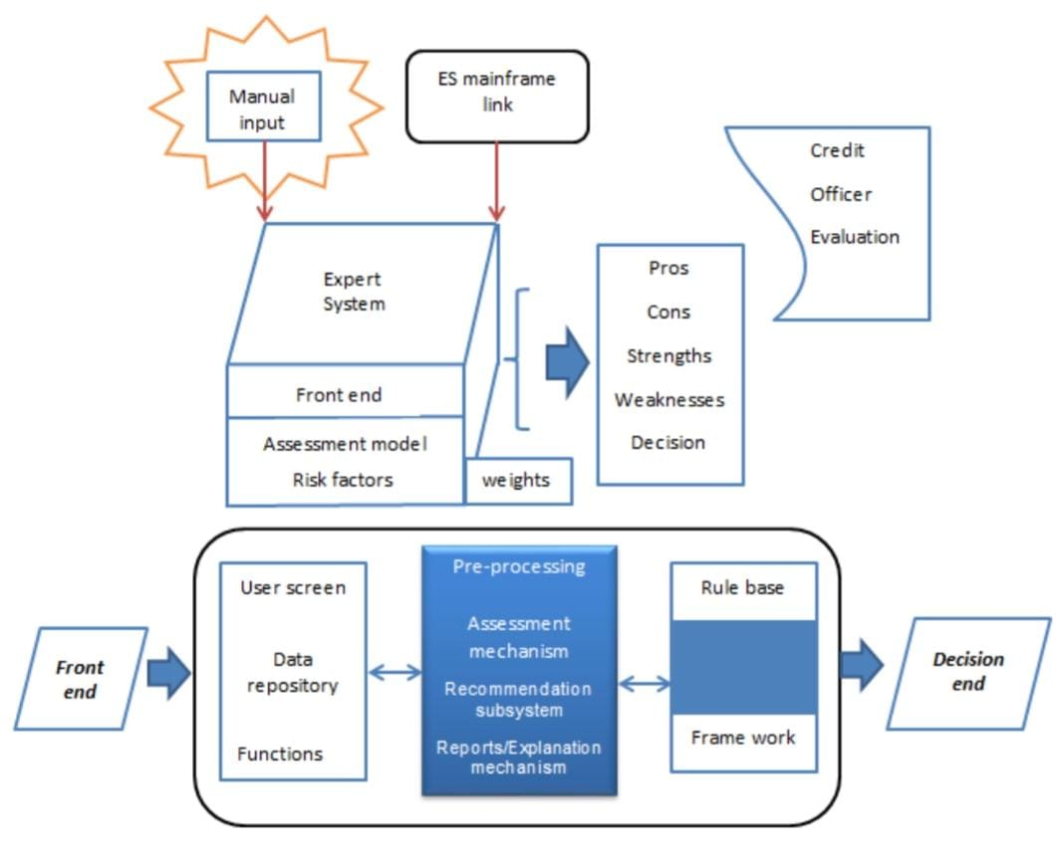
ARCHITECTURAL DIAGRAM:

Slide 9
MODULES:
Input and Preprocessing Module
1
User Interface Module
2
DATA PREPARATION MODULE
6
Alerting and Output Module
5
3
SCORING MODULE
4
Database Module

Slide 10
MODULE 1: INPUT AND DATA COLLECTION MODULE
DESCRIPTION:
Function: Gathers data from various sources (credit bureaus, transaction records, alternative data like social media if applicable).
FEATURES:
API Integration: Integrates with external databases and APIs to fetch credit and transaction data.
Data Validation: Ensures that the incoming data is accurate, complete, and consistent.
Data Logging: Records data fetch logs for monitoring and debugging.

Slide 11
MODULE 2: DATA PREPARATION MODULE
DESCRIPTION:
The purpose of data cleaning is to ensure that all data used in the model is of high quality, free from errors, and consistent across all records. Poor data quality can lead to inaccurate predictions and biased scores, making data cleaning a foundational step.
FEATURES:
Data Cleaning: Handles missing values, outliers, and data inconsistencies.
Feature Engineering: Extracts and creates important features, such as debt-to-income ratio, credit utilization, and payment history.
Data Transformation: Normalizes and encodes data to make it suitable for machine learning algorithms.

Slide 12
MODULE 3: SCORING MODULE
DESCRIPTION:
The Scoring Model Module is central to the credit scoring system, as it transforms input data into a meaningful credit score through advanced machine learning models.It is exposed to a labeled dataset containing historical data on applicants, including features like income, credit history, debt-to-income ratio, and past payment behaviors. The model learns to associate these features with actual creditworthiness (target variable), adjusting its internal parameters to minimize prediction error.
FEATURES:
Scoring Calculation: The inference engine feeds the data into the trained model, which processes each feature, applies the learned weights, and produces a score. This score is typically a numerical value representing the predicted creditworthiness of the applicant.
Output: The result is a credit score that can be interpreted to determine an applicant’s creditworthiness. The score is often scaled or binned int

Slide 13
MODULE 4: DATABASE MODULE
DESCRIPTION:
A Credit Scoring System database module organizes and manages data for assessing an individual's or entity's creditworthiness. Below is a suggested structure and content for the database module of a credit scoring system.
FEATURES:
Maintain detailed payment records, including on-time, late, and defaulted payments.
Track loan repayment behaviors across multiple loans.Store user profiles with personal and contact details.
Track user demographics for credit analysis.

Slide 14
MODULE 5: ALERTING AND OUTPUT MODULE
DESCRIPTION:
The Alerting and Output Module of a credit scoring system is designed to provide timely notifications and actionable insights to users and administrators. This module ensures proactive communication by sending alerts for payment reminders, credit score updates, overdue loans, or suspicious activities.
FEATURES:
Payment Reminders: Notify users about upcoming loan repayment deadlines.
Credit Score Updates: Inform users of significant changes in their credit scores.
Overdue Alerts: Highlight missed payments or overdue amounts.
Fraud Detection Alerts: Flag unusual or suspicious activities.

Slide 15
MODULE 6: USER INTERFACE MODULE
DESCRIPTION:
The User Interface (UI) Module of a credit scoring system serves as the primary interaction layer between users and the system. It is designed to be intuitive, user-friendly, and responsive, ensuring seamless navigation for both technical and non-technical users.
FEATURES:
Clean and intuitive layout for effortless navigation.
Responsive design for access across devices (desktop, tablet, mobile).

Slide 16
ADVANTAGES
1. Quickens loan and credit approval processes.
2. Uses standardized data, minimizing human bias.
3. Accurately predicts borrower risk for lenders.
4. Expands credit access by providing a quantifiable score.6. Encourages responsible credit behavior.
5. Reduces manual work for lenders.
6. Helps individuals track and improve credit health

Slide 17
APPLICATIONS
1. Mental Health Impact.
2. Financial Inclusion.
3. Housing Access.
4. Consumer Education.
5. Bias in Scoring.
6. Credit Recovery.
7. Credit Improvement Apps.

Slide 18
CONCLUSION:
The credit scoring system uses machine learning algorithms, ensuring accurate predictions of creditworthiness by analyzing borrower financial data, reducing lender risks, and promoting fair access to credit for underserved populations.
Advanced feature engineering and data preprocessing enhance model performance, ensuring consistency and reliability across diverse applicant profiles, thereby supporting efficient, transparent decision-making in credit risk assessment for financial institutions.

Slide 19
REFERENCES
1.Credit Score Prediction System using Deep Learning and KMeans Algorithms -Tripathi, D., Edla, D. R., Cheruku, R., & Kuppili, V. (2022).
2.Credit scoring using machine learning and deep Learning-Based models-Deng L, Yu D (2024) Deep Learning: Methods and Applications. Found Trends Signal Proc 7: 197–387.
3.A recent review on optimisation methods applied to credit scoring models-Abdou, A.J. and Pointon, H.A. (2023),
4.Analyzing Machine Learning Models for Credit Scoring with Explainable AI and Optimizing Investment Decisions-Doshi-Velez, F.,Kim, B. (2021).
5.Credit scoring methods: Latest trends and points to consider-Xiao H, Xiao Z, Wang Y. Ensemble classification based on supervised clustering for credit scoring. (2020)

Slide 20
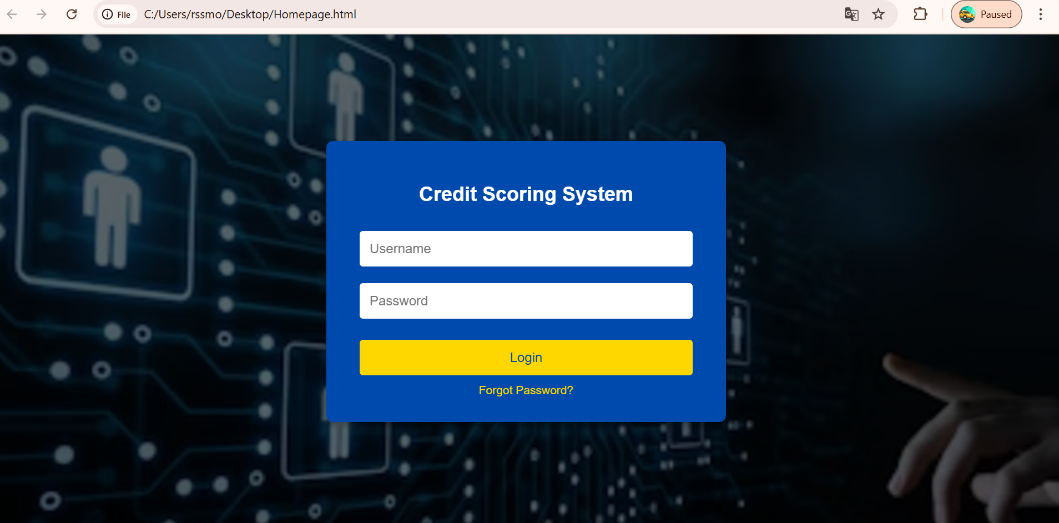
SCREENSHOTS

Slide 21
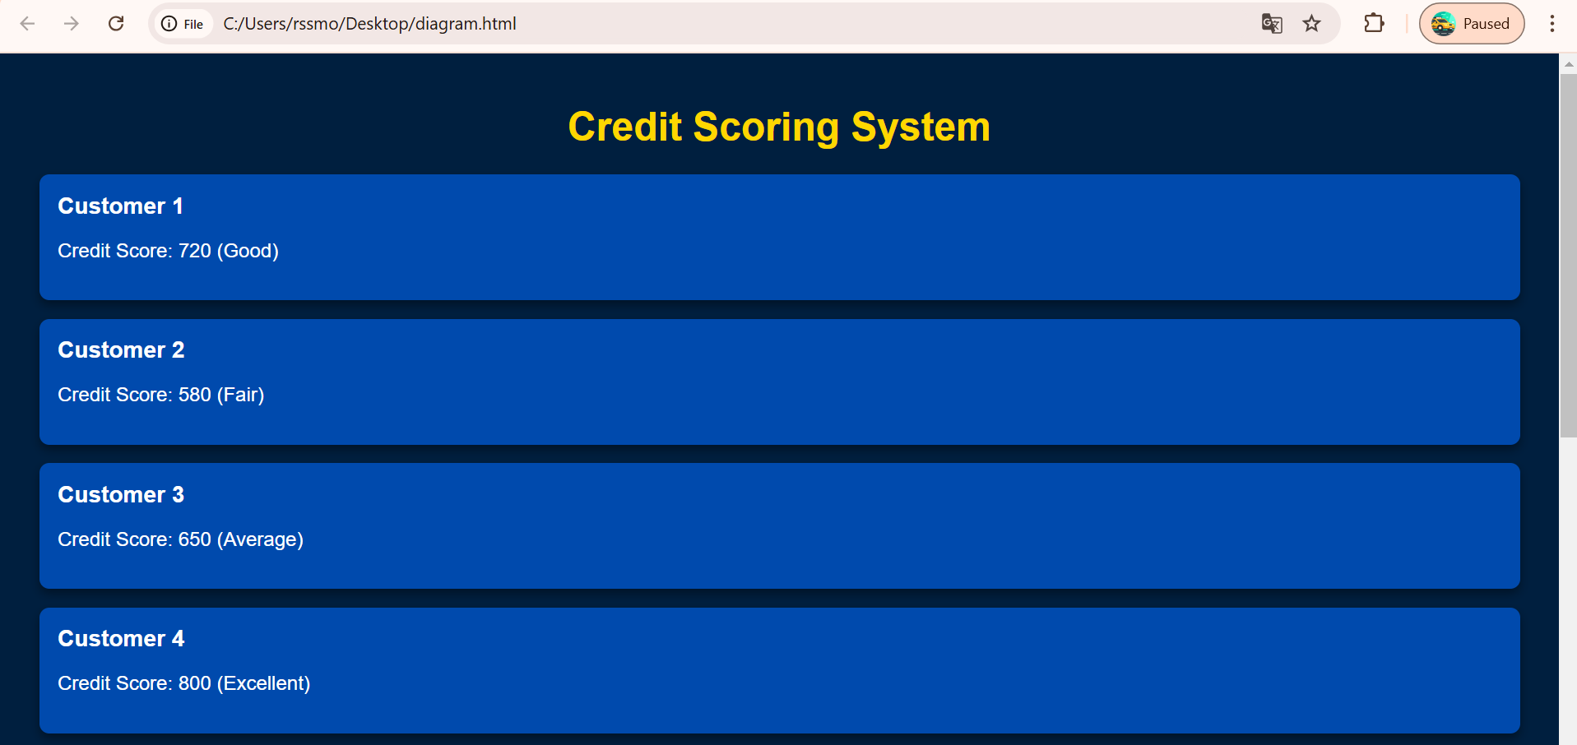
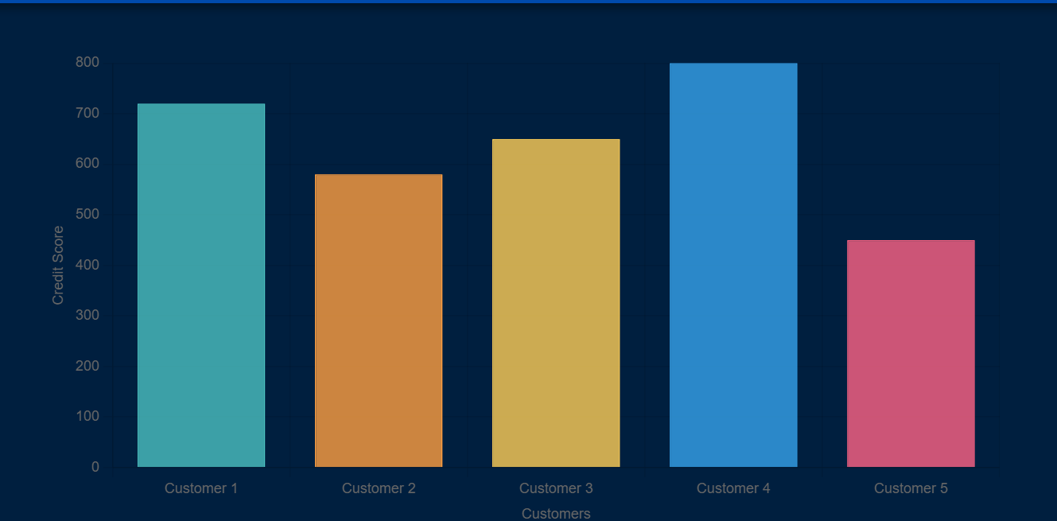

Slide 22
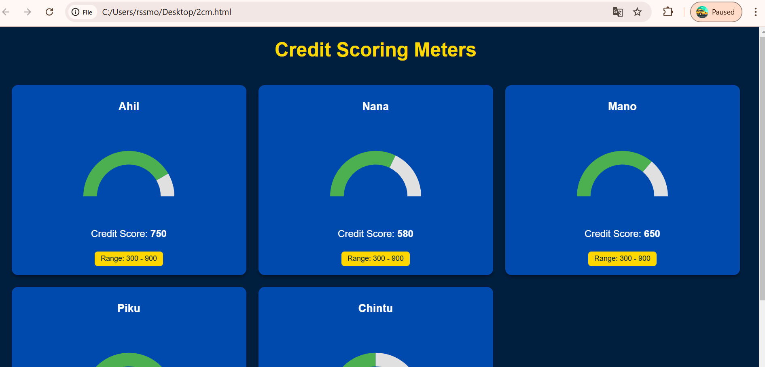
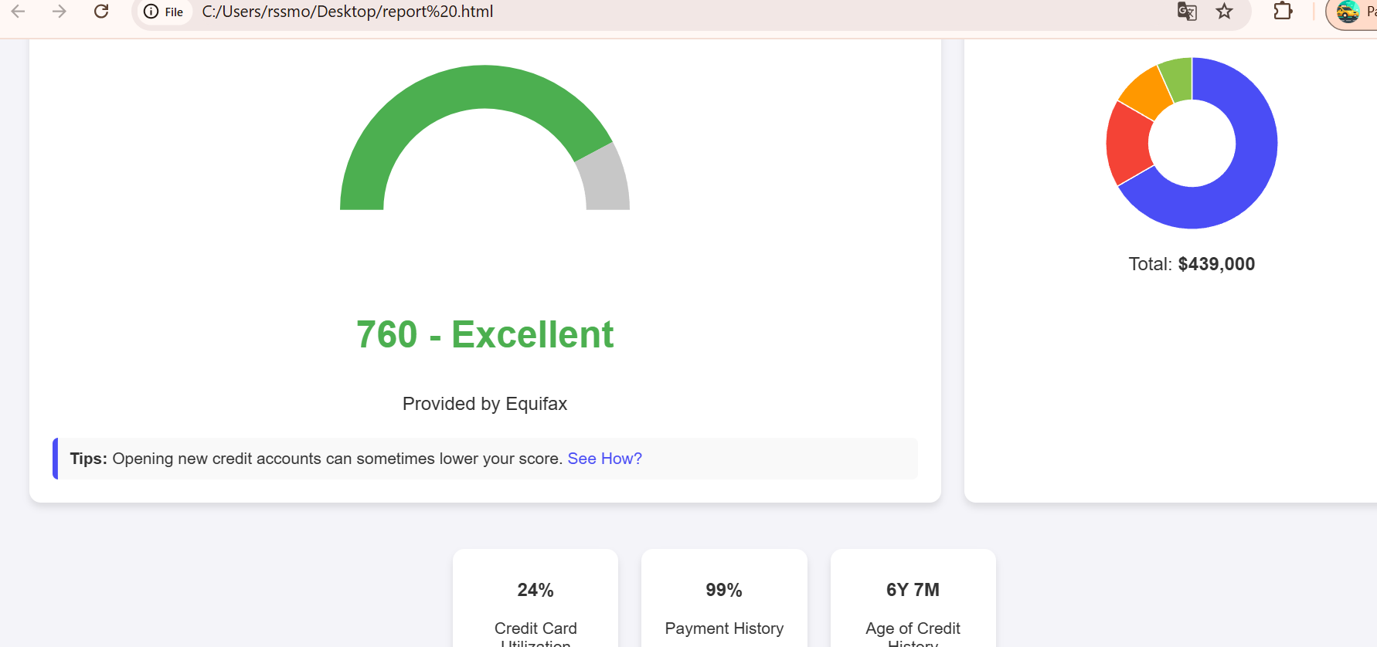

Slide 23
THANK YOU

